Slide 1
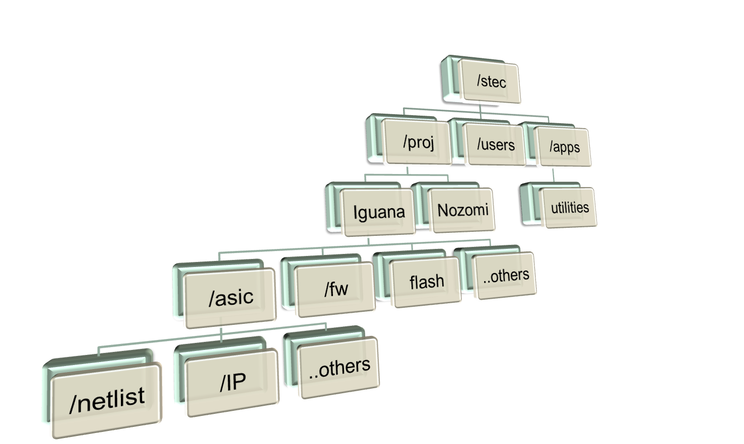
Directory Structure

Slide 2
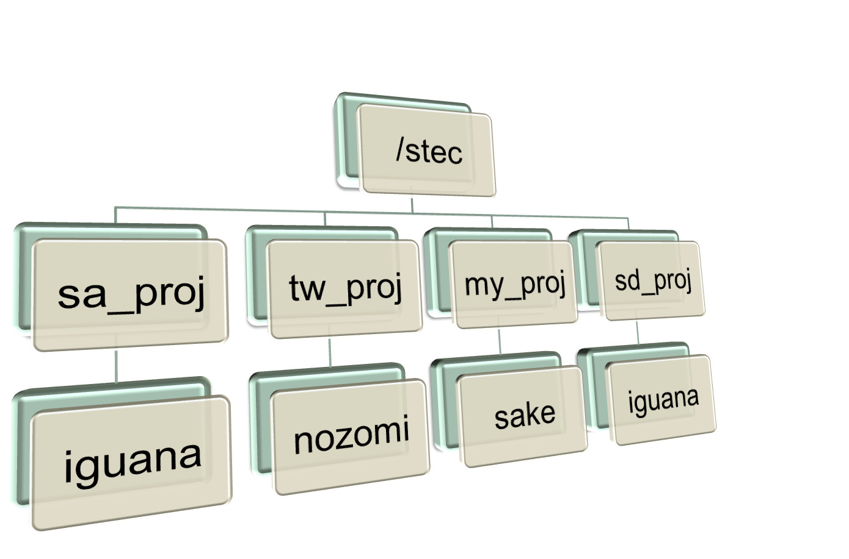
Remote Project Directory Access

